Slide 1
Quality Control on Crowd-sourcing Image Annotation using Direct Assessment
CA685
Navaneethan Rajasekaran

Slide 2
Introduction
Image annotation has been an ongoing research topic
Direct Assessment (DA) is a methodology for crowd-sourcing human assessments of translation quality
We developed a new assessment strategy based on DA to quality control on crowd-sourcing image annotation.
Notes:
Crowd-sourcing is widely used in industry and research for manual image annotation
In DA, Some of the poorly translated sentences and perfectly translated sentences are presented to workers intentionally, with Machine translated system outputs and asked them to evaluate it to identify their reliability.
Crowd-sourcing is the practice of obtaining needed services from large group of geographically dispersed people via the Internet .
Approved by ethics approval panel.
The strategy will allow researchers to source quality data cheaply and on a large scale.

Slide 3
Image Annotation Techniques
Manual annotation - Process of utilizing human computation to annotate images.
Automatic annotation - Process by which computer system assigns metadata in the form of captioning or keywords to a digital image automatically
1. Image segmentation (Alexi et al,2005)
2. Image Annotation by coherent language model and active learning (Rong et al,2004)
3. Content-Based Image Annotation Refinement (Wang et al,2007)
Notes:
Manual annotation of image content is considered “best case” in terms of accuracy
Image segmentation algorithms are used to classify the images into a number of unevenly shaped blob regions .
Image Annotation by coherent language model and active learning [8] uses the word to word correlation, as image features are inadequate in establishing the corresponding word annotation. To integrate the word-to-word correlation, it approximates the probability of annotating an image with a set of words.
Content-Based Image Annotation Refinement approach improves the existing annotations of images. It refines the conditional probability so that more precise annotations will have higher probabilities.

Slide 4
Popular Dataset and their Annotation Techniques
MS COCO (Tsung-Yi et al,2014)
COCO CN (Xirong Li et al,2018)
STAIRS (Yuya et al,2018)
Flickr30K (young et al,2014)
Multi30K (Elliott et al,2016)
Flickr30k Entities (Bryan A et al,2015)
Notes:
Microsoft Common Object in Context (MS COCO) is the largest dataset containing 300k images . The creation of the dataset drew upon extensive crowd-source involvement via novel user interface.
COCO CN dataset is the recent extension of MS COCO data set with manually translated Chinese image descriptions. COCO CN argued that there is number of typos and misspelling in the MS COCO and the quality of crowd-sourced data is unresolved. They developed a web-based image annotation system that allows users to annotate images remotely and independently. The author justified that this approach has improved the quality of crowd-sourcing work.
STAIR is the extension of MS COCO which has 820,310 Japanese captions for 164,062 images. The English captions were manually translated to Japanese by crowd-source with certain provided guidelines . The quality of the caption is evaluated by sampling inspection.
Flickr30k Dataset contains 31,014 images sourced from online photo-sharing websites. Each image is paired with five English image descriptions, collected from crowd-sourcing.
Multi30k dataset extends the Flickr30K dataset with I) German translations created by professional translators over a subset of the English descriptions, and ii) descriptions crowd- sourced independently of the original English descriptions.

Slide 5

Metrics for Automatic Evaluation of Machine Translation
BLEU
NIST
F-Measure
METEOR
Notes:
BLEU (bilingual evaluation understudy) was one of the first metrics to claim a high correlation with human judgments of quality and remains one of the most popular automated and economic parameters.
Scores are computed for single translated segments—generally sentences—by matching them with a set of good quality reference translations.
NIST (National Institute of Standards and Technology) precision measure is a metric used to evaluate the MT variants. The more of these N-grams that a translation shares with the reference translations, the better the translation is judged to be. NIST is intended as an enhanced version of BLEU.
The F-measure is a metric which measures the harmonic mean of precision and recall. The metric is based on the search for the most suitable match between the candidate and reference translations
The Meteor automatic evaluation metric scores machine translation hypotheses by aligning them to one or more reference translations. Meteor is an improved version of F-Measure
There is no best MT automatic evaluation metric because different tasks have different interpretations of what constitutes a good, fit for purpose translation.

Slide 6

Dataset
Flickr30k Entities
Dataset is the test data used in WMT17 for Multimodal Machine Translation task
Dataset contains 1,000 images
Notes:
Subset of Flickr30K Entities. The dataset proposes a benchmark task of phrase localization.

Slide 7

Direct Assessment (DA)
Direct human MT evaluation methodology.
Key Features
Used to evaluate both adequacy and fluency
Incorporates mechanisms for quality control
cheap
requires only monolingual annotators
Employed in human evaluation campaign of WMT17.
Notes:
Direct Assessment was demonstrated to show that it was possible to measure MT systems reliably based on crowd- sourced judgments alone

Slide 8
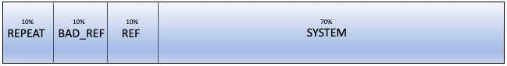
Direct Assessment
Amazon Mechanical Turk is used as a crowd-sourcing platform.
A HIT contains hundred translation assessments each, one per screen.
Distribution of translation in a HIT
Notes:
An additional specification was that only native speakers of the language complete HITs, in this case it was English

Slide 9
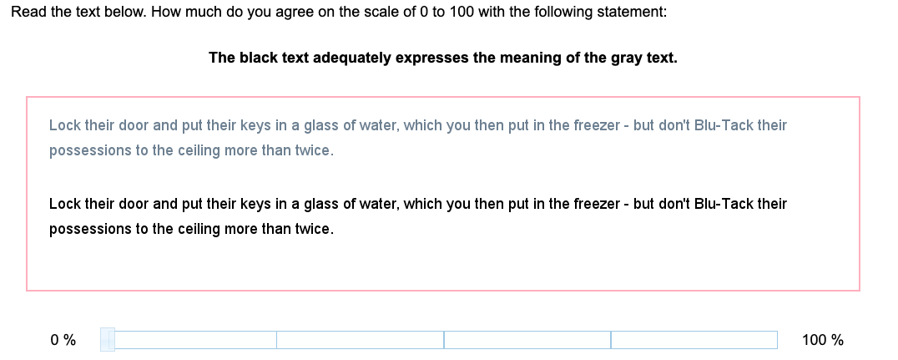
Direct Assessment
REF Translation
REF Translation

Slide 10
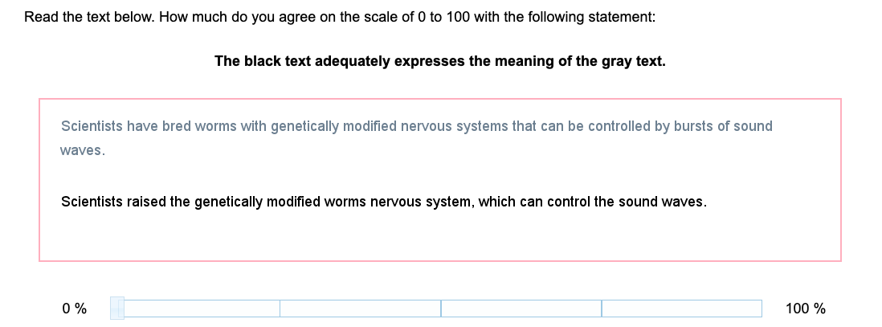
Direct Assessment
SYSTEM Translation

Slide 11
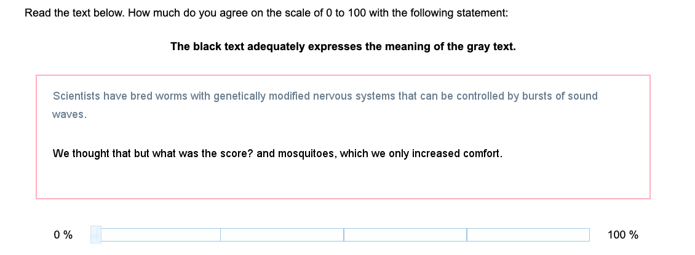
Direct Assessment
BAD Translation

Slide 12
Direct Assessment
The null hypothesis to be tested for each Amazon Mechanical Turk worker - The score difference for MT system translations is not less than the score difference for bad reference pairs.
To test statistical significance, the paired t-test is used
P < 0.05 as a threshold of reliability is used to assess the workers

Slide 13
Direct Assessment for Crowd-sourcing Image Annotation
Direct Assessment is technically modified
Each HIT contains thirty translation assessments shuffled randomly and seventy Images, one per screen

Slide 14

Direct Assessment for Crowd-sourcing Image Captions
Notes:
Although such items appeared to be too obvious to be useful in assessments, they indeed acted as a further modest hurdle for workers to meet and identified many workers not completing the task with due care.

Slide 15
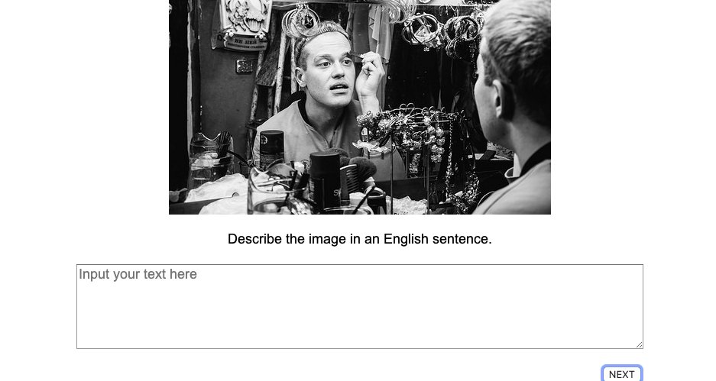
Direct Assessment for Crowd-sourcing Image Captions

Slide 16
Assumptions
The score difference for system outputs is not less than the score difference of bad references.
Paired t-test
The score difference for references is not less than the score difference of bad references
Mann-Whitney U test
Notes:
The experiment is divided into stage 1 and stage 2.

Slide 17
Experiment- Stage 1
Carried out to evaluate the initial setup
15 unique workers are asked to annotate similar images of the HIT
Workers are not explicitly made aware of quality-control employed in the HIT

Slide 18
Stage 1 – Result and Analysis
6 out of 15 workers are identified as reliable by DA with assumption A, where only 4 out of 6 have annotated the image properly
9 out of 15 workers are identified as reliable by DA with assumption B, where only 6 out of 9 have annotated the image properly.

Slide 19
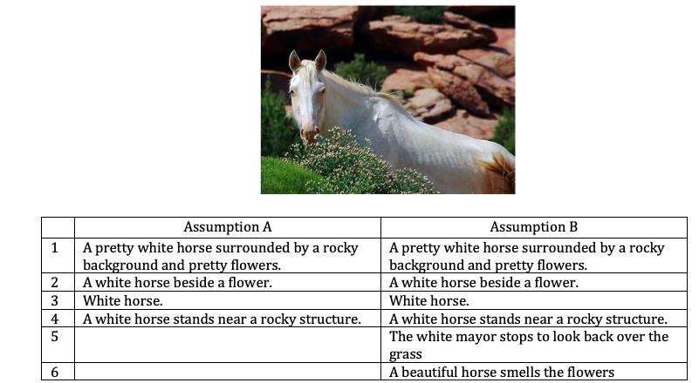
Stage 1 – Result and Analysis

Slide 20
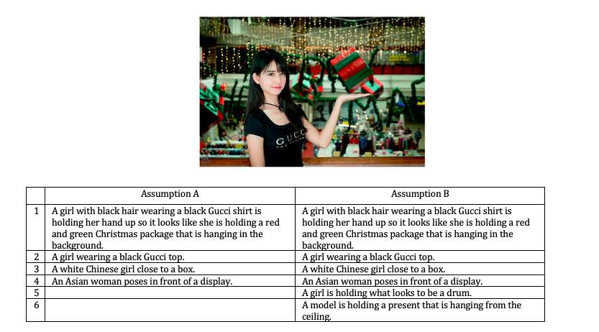
Stage 1 – Result and Analysis

Slide 21
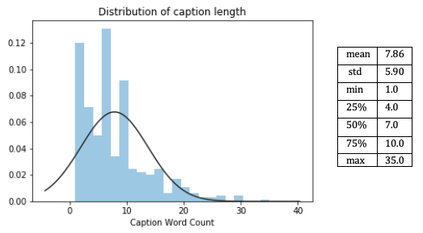
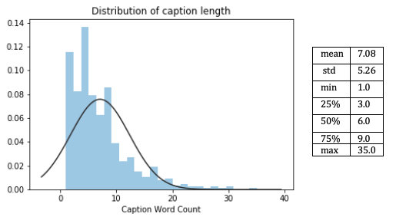
Stage 1 – Result and Analysis
caption length based on assumption A caption length based on assumption B
Notes:
The analysis of captions shows that there is no significant difference between the length of captions submitted by reliable workers satisfying assumption A and assumption B.

Slide 22
Experiment – Stage 2
The dataset is divided 14 HITs, with each Hit consisting of 70 images,
Eight workers are asked to complete each HIT,
7,840 captions are collected for 980 images, with each image consisting of 8 captions.
Notes:
The experiment setup is evaluated in stage 1 and is limited to only a small sample of workers and images. As part of stage 2, the complete dataset is used.

Slide 23
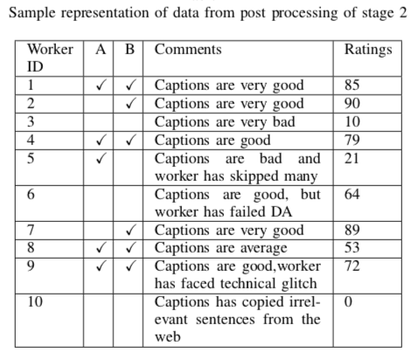
Experiment – Stage 2
Each worker is evaluated with assumption A and assumption B.
Each worker is rated manually depending on the quality of their captions.

Slide 24
Stage 2 – Result and Analysis
17% of the workers are identified as reliable based on assumption A.
40% of the workers are identified as reliable based on assumption B.
Quality works are identified more by DA with assumption B than DA with assumption A
 | Positive | Negative
Positive | 12 | 64
Negative | 29 | 7
 | Positive | Negative
Positive | 32 | 44
Negative | 19 | 17
Confusion Matrix on assumption A Confusion Matrix on assumption B
Notes:
The reliable workers can differentiate perfectly translated sentences from bad translated sentences easily

Slide 25
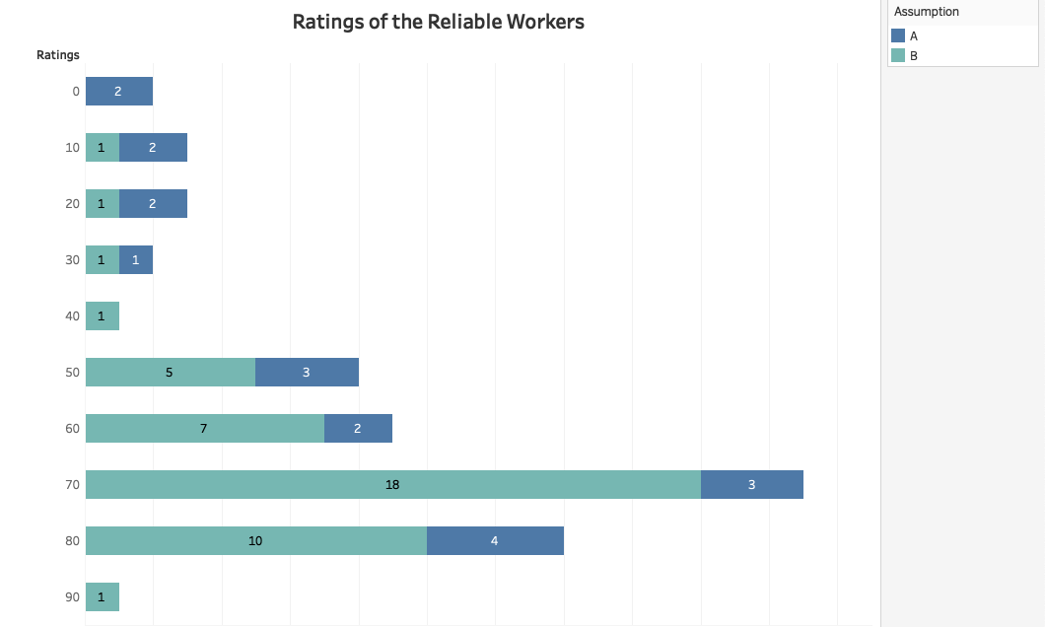
Stage 2 – Result and Analysis

Slide 26
Conclusion
High pay rate has the risk of attracting unreliable workers.
Significant rate of accuracy in identifying reliable workers.
Some of the reliable workers have failed to pass the quality assessment.
Workers copied irrelevant contents from web.
Strategy found to be swift in gathering quality works.
The pay rate and a number of images to include in a HIT should be explored further .
Notes:
This strategy will be able to collect quality data and can be used for different crowdsourcing task

Slide 27

Thank You

